Slide 1
Core Methods in Educational Data Mining
EDUC 6191 Fall 2022

Slide 2
Basic Assignment
Any questions or comments about this week’s basic assignment?

Slide 3
Association Rule Mining/ Sequential Pattern Mining
Any questions about association rule mining or sequential pattern mining in general?

Slide 4
Logistic Knowledge Tracing (LKT) (Pavlik et al., 2021)
A broad framework for knowledge tracing models based on logistic regression

Slide 5
Performance Factors Analysis (PFA) (Pavlik et al., 2009)
The first version of LKT (Well, there was LFA/AFM but it really doesn’t count – was not usable in a running learning system)

Slide 6


PFA

Slide 7
What do each of these parameters mean?

Slide 8
Performance Factors Analysis
What are the important differences in assumptions between PFA and BKT?
What does PFA offer that BKT doesn’t?
What does BKT offer that PFA doesn’t?

Slide 9
How Does PFA
Represent learning?
As opposed to just better predicted performance because you’ve gotten it right

Slide 10
How Does PFA
Represent learning?
As opposed to just better predicted performance because you’ve gotten it right
Is it ρ ?
Is it average of ρ and γ?

Slide 12
What do each of these mean?
When might you legitimately get them?
ρ < 0
γ < ρ
γ < 0

Slide 13
Degeneracy in PFA (Maier et al., 2021)
Three degenerate cases
γ < 0
γ < ρ
γ = ρ = 0

Slide 14
Degeneracy in PFA (Maier et al., 2021)
Three degenerate cases
γ < 0
γ < ρ
γ = ρ = 0
One seemingly degenerate (but not) case
4. ρ > 0
“It is worth noting that a fourth case when ρ > 0 -- is not degenerate, due to the multiple functions the parameters perform in PFA. In this case, the rate of learning the skill may outweigh the evidence of lack of student knowledge that an incorrect answer provides. So long as γ > ρ, a positive ρ is conceptually acceptable.”

Slide 15
Comments? Questions?

Slide 16
β Parameters
Pavlik proposes three different β Parameters
Item
Item-Type
Skill
Result in different number of parameters
And greater or lesser potential concern about over-fitting
What are the circumstances where you might want item versus skill?

Slide 17
Addressing Degeneracy (Maier et al., 2021)
Simply bound γ and ρ
Does not reduce model performance substantially (just like BKT)

Slide 18
Causes of Degeneracy (Maier et al., 2021)
If β is used at the Skill or Item-Type level
And the learning system moves students from easier to harder items within a “skill”
Then γ < 0.
If items are tagged with multiple skills, collinearity between skills could produce degenerate parameters.

Slide 19
Comments? Questions?

Slide 20
Compensatory or Conjunctive?
Compensatory
Conjunctive
Which do you think would be better?
∏

Slide 21
Compensatory or Conjunctive?
Compensatory
Conjunctive
Compensatory fits data better for PFA (Maier et al., 2021)
Oddly, conjunctive was better for BKT (Pardos et al. 2008)
∏

Slide 22
Is PFA used in the real world?
Yes, but by far fewer learning systems than BKT
Maier et al. (2021) discuss its use in Reveal Math 1

Slide 23
Using PFA in the real world
One key in real-world use is handling rare skills, which can impact model inferences on common skills as well
Because PFA is used in cases with items tagged to multiple skills
(Maier et al., 2021) handle this by creating a “catch all” skill for rare skills
Using average parameters from all common skills also works

Slide 24
Other questions, comments, concerns about PFA?

Slide 25
Beyond PFA

Slide 26

PFA-Decay (Gong, Beck, & Heffernan, 2011)
Weights actions further back in order less strongly
Adds an evidence decay parameter δ
Substitutes
For the previous summation
Very slightly higher AUC (0.003)

Slide 27
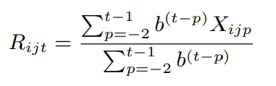
R-PFA (Galyardt & Goldin, 2014)
Weights actions further back in order less strongly
Looks at proportion of success-failure, weighting by distance in order from current action
Adds an evidence decay parameter b
Adds “ghost practices” before current practice to make math work
Substitutes
For the previous summation
A little higher AUC (0.003-0.027) (Pavlik et al., 2021)

Slide 28
Questions? Comments?

Slide 29
LKT
Creates a general framework for variants of PFA

Slide 30
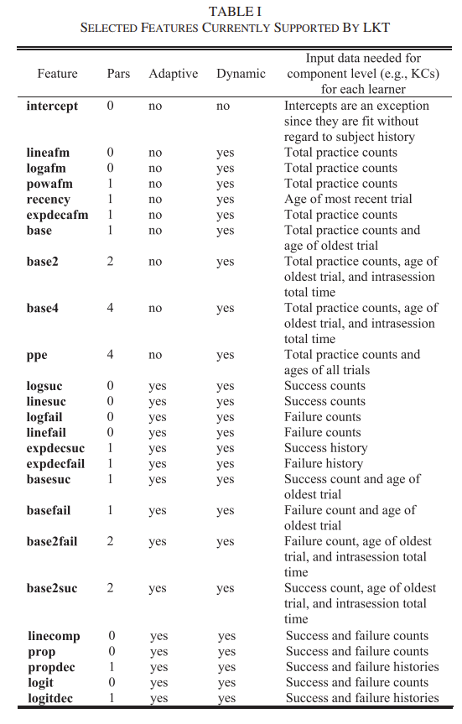

Slide 31
Comments? Questions?

Slide 32
LKT
Surprising omission: actual time in seconds

Slide 33
Comparison of variants
6 data sets in variety of systems and domains
Models that represent forgetting in some fashion typically perform better
Stronger effects for facts than skills

Slide 34
Comments? Questions?

Slide 35
Algorithms that fit student-level term
A lot of other logistic regression algorithms for student knowledge modeling out there
One important category that I have not discussed in detail is algorithms that fit a student-level ability term
Classic IRT
AFM/LFA
DASH/DAS3H

Slide 36
Algorithms that fit student-level term
When an algorithm does this, it typically can’t be used in real time
The student-level term is fit using all the student’s data
This means that the student’s future is used to predict their past
Thus, the model can only be used after the fact

Slide 37
Algorithms that fit student-level term
This can still be useful for analysis
But papers that compare algorithms that fit a student-level term using future data to algorithms that don’t do this…
Should be up-front about this
And not all such papers are

Slide 38
Exception
There are IRT variants that build up estimates of student ability over time
TIRT (Wilson et al., 2016)
ELO (Klinkenberg & Straatameier, 2011; Pelanek, 2014)
These can be used in real-time

Slide 39
Questions? Comments?

Slide 40
Final Comments or Questions?

Slide 41
Next Classes
November 3
Text Mining
Valdemar lecturing while I’m at Penn event in NYC
Basic Assignment: PFA due
November 10
Deep Knowledge Tracing
November 17
Knowledge Structure Discovery

Slide 42
The End

